Slide 1
Design Critique:
Florida Gun Deaths
John F. Tripp

Slide 2
Design Critique
How is this visualization using size, color, and placement to communicate?
Is this visualization adding anything to the text?

Slide 3
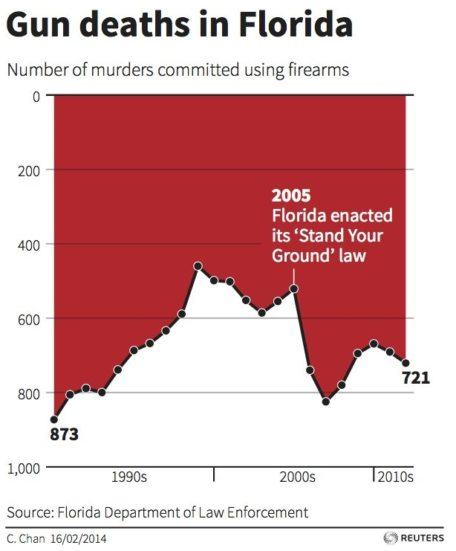
What happened after 2005?
Image Source: http://www.businessinsider.com/gun-deaths-in-florida-increased-with-stand-your-ground-2014-2

Slide 4
What happened after 2005?
We will return to this slide
several times as an example
of what NOT to do…
Image Source: http://www.businessinsider.com/gun-deaths-in-florida-increased-with-stand-your-ground-2014-2

